Slide 1
INTER-PROCESS COMMUNICATION

Slide 2
TABLE OF CONTENT
What is Inter process communication
Types of Processes
Model of IPC

Slide 3
INTER-PROCESS COMMUNICATION
Interprocess communication (IPC) is a capability supported by operating system that allows one process to communicate with another process.
Process can be running on the same computer or on different computers connected through a network.
IPC enables one application to control another application and for several application to share same data without interfering with one another.
IPC is required all multiprogramming systems but it is not generally supported by single-process operating system such as DOS.

Slide 4
INTER-PROCESS COMMUNICATION
INDEPENDENT PROCESSES
COOPERATING PROCESSES
A process that cannot affect or be affected by another process executing in the system.
An independent processes does not share data with any other process.
A process that can affect or be affected by another process executing in the system.
A cooperating process shares data with other process.

Slide 5
INTER-PROCESS COMMUNICATION
Advantage of Cooperating process
Information sharing
Computation speedup
Modularity
Convenience

Slide 6
MODEL OF INTER-PROCESS COMMUNICATION

Slide 7
INTER-PROCESS COMMUNICATION
SHARED MEMORY MODEL
It establishes a region of memory that shared by cooperating process.
The process exchange information by reading and writing data to shared memory region.
This model is faster than message passing model and provide maximum speed and convenience.
Example-
A multi-threaded application that uses shared memory to communicate between different threads

Slide 8
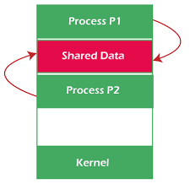

Slide 9
Producer-Consumer Problem
Producer process: It produces information that is consumed by a consumer .
For Example : A complier may produce assembly code which is consumed by an assembler.
Solution of producer and consumer problem uses shared memory.
To allow producer and consumer process to run concurrently, we must have available a buffer of items that can be filled by the producer and emptied by the consumer.

Slide 10
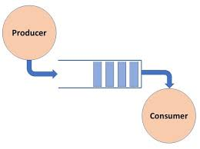
Producer Consumer Problem
This buffer will reside in a region of memory that is shared by producer and consumer processes.
A producer can produce one item while the consumer is consuming another item.
The producer and consumer must be synchronized, so that the consumer does not try to consume an item that has not yet been produced.

Slide 11
Producer Consumer Problem
There is two kinds of buffer:
Unbounded-Buffer : Place no practical limit on the size of buffer.The Producer can always new items and consumer may have to wait for new items.
BOUNDED-BUFFER: Assumes that there is a fixed buffer size. When it is full the producer must wait until there is some space in the buffer before it can produce new item and the consumer must wait if the buffer is empty.

Slide 12
INTER-PROCESS COMMUNICATION
MESSAGE PASSING MODEL
In message passing model the cooperating processes communicate by exchanging messages with one another.
This model is useful for exchanging small amount of data.
It can implemented more easily than shared memory model.
Example-
Web browsers / Web Servers
It provide two operation.
Send
Receive

Slide 13
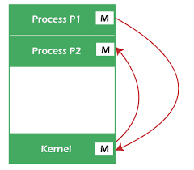

Slide 14
Direct Communication
Each process that wants to communicate must name the sender or receiver of the communication.
There is two scheme of direct communication Symmetric communication Asymmetric communication.
Symmetric communication: It requires that both sender and receiver process must name each other to communicate.
Asymmetric communication: Only the sender process must name the recipient(receiver).The recipient process does not need to name of the sender process.
Send ( )and Receive( ) functions in symmetric communication are follows.
send (P, message) – send a message to process P
receive(Q, message) – receive a message from process Q

Slide 15
Direct Communication
Send ( )and Receive( ) functions in Asymmetric communication are follows.
send (P, message) – send a message to process P
receive(id, message) – receive a message from ant process. ID refers to the name of the process with which communication takes place.
Properties of communication link
Links are established automatically
A link is associated with exactly one pair of communicating processes
Between each pair there exists exactly one link
The link may be unidirectional, but is usually bi-directional

Slide 16
Indirect Communication
Messages are directed and received from mailboxes (also referred to as ports)
Each mailbox has a unique id
Processes can communicate only if they share a mailbox
Properties of communication link
Link established only if processes share a common mailbox
A link may be associated with many processes
Each pair of processes may share several communication links
Link may be unidirectional or bi-directional

Slide 17
Indirect Communication
Operations
create a new mailbox
send and receive messages through mailbox
destroy a mailbox
Primitives are defined as:
send(A, message) – send a message to mailbox A
receive(A, message) – receive a message from mailbox A

Slide 18
Indirect Communication
Mailbox sharing
P₁, P₂, and P₃ share mailbox A
P₁, sends; P₂ and P₃ receive
Who gets the message?
Solutions
Allow a link to be associated with at most two processes
Allow only one process at a time to execute a receive operation
Allow the system to select arbitrarily the receiver. Sender is notified who the receiver was.

Slide 19
THE END

